Slide 1
Introduction to Computer Science
Raj Bhatnagar
Computer Science Department
University of Cincinnati

Slide 2
What is Computer Science?
The main focus of this field is on: “How To?”
  How to solve computational problems?
  How to find suitable web pages for a query on google?
  How to sort a billion numbers in descending order?
  How to secure your information in computers?
  How to execute five+ apps simultaneously on your phone?
  How to make Siri/Alexa understand your sentences?
  How to make a car drive itself?
  How to multiply two very large matrices?

Slide 3
Role of “Computer” in Computer Science
Computer is only a “Tool”
A surgeon’s tool is a knife
A sculptor’s tool is a chisel
A painter’s tool is a brush
Computer Science is not about how to make a computer
It is about how to use thee computer as a tool to solve problems

Slide 4
Role of “Science” in Computer Science
Well. . . . . .
Science is about understanding Nature through observations
  Physics: Models for manipulating/predicting Force
  Chemistry: Models for manipulating/predicting Atomic Bonds
  Biology: Models for manipulating/predicting Living Cells
Computer Science is about:
  Models for manipulating/predicting Information
Science is about Real Material Nature
Computer Science is about: Abstract mental entities

Slide 5
Computer “Science” vs. “Engineering”
“Engineering is design under constraints… Engineering is synthetic - it strives to create what can be, but it is constrained by nature, by cost, by concerns of safety, reliability, environmental impact, manufacturability, maintainability and many other such 'ilities.' ...”
William Wulf
Computer Engineering is about designing and building the hardware box we call a computer.

Slide 6
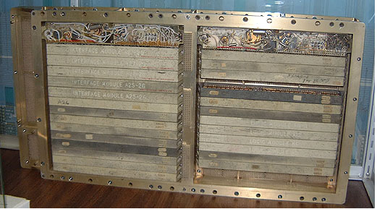
Apollo Guidance Computer, 1969
Why did they need to fit the guidance computer in the rocket?
1 Cubic Foot

Slide 7
Measuring Computers’ Memory
1 bit = smallest unit of information
  True or False
  0 or 1
1K bits = 2^10 bits = 1024 bits
1M bits = 2^20 bits
1G bits = 2^30 bits

Slide 8
How much power?
Apollo’s Computer: 30720 bits of memory
Laptops have ~8-16 GB (RAM)
  1 Gigabyte = 1024 Megabytes,
  1 Megabyte = 1024 Kilobytes,
  1 Kilobyte = 1024 Bytes,
  1 Byte = 8 bits
  (* 1024 1024 1024 8) *8
Your laptop has 10 million times memory of what Apollo’s computer had
You will understand this
notation soon…but don’t worry
if you don’t now
If Apollo Guidance Computer power is 1 inch, you have ~35 miles!

Slide 9
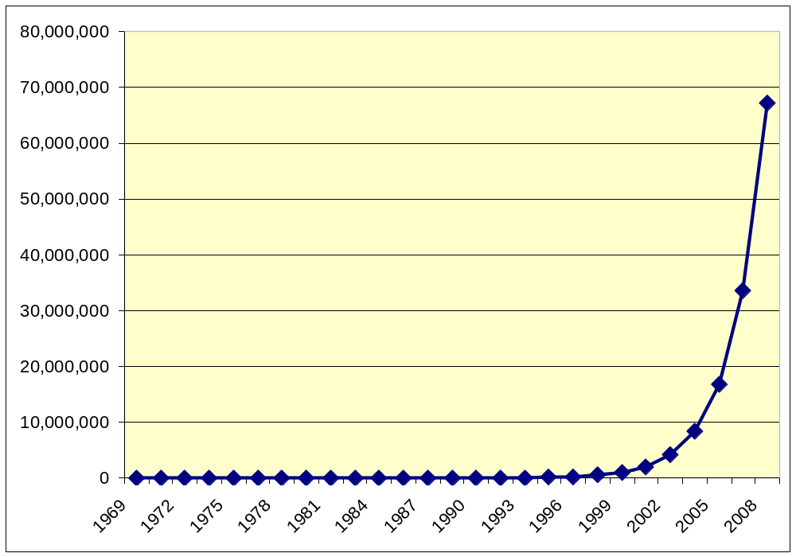
Computing Power 1969-2010
(in Apollo Control Computer Units)
Moore’s “Law”: computing power roughly doubled every 18 months!
But it stopped doubling around 2012

Slide 10
Constraints Computer Scientists Face
Not like those faced by engineers:
  Cost, weight, physics, etc.
  If ~20 Million times what people had in 1969 isn’t enough for you, wait until 2010 and you will have 80 Million times…
More like those faced by Musicians and Poets:
  Imagination and Creativity
  Complexity of what we can understand

Slide 11
How to Solve a Problem
Many ways to represent, model, solve a problem
Each one of us solves a problem differently
  Many ways to multiply two numbers
Railway Engine
  Steam, Diesel, Electric
  Each one solves the same problem,
  But in a completely different way
Problem Solving by humans and computers
  Their ways of understanding and solving the problems are completely different

Slide 12
Problems Solving: Computers Vs. Humans
We want computers to solve our large and complex problems
Conceptual/Mental tools for problem solving
  Tools used by humans
  Tools used by computers
  The two are very different
If we want computers to solve problems
  Design solutions the way computers perceive them
  This way of thinking is called computational thinking

Slide 13
How to Model a Problem?
Problem: There are 1400 players in a Tennis tournament; Loser of every match is dropped; How many games before the champion is selected?
Solution-1: 700 matches to select first level winners; 350 matches to win next level winners, 175 at the next level, and so on; => 700+350+175+. . . . . games

Slide 14
How to Model a Problem?
Problem: There are 1400 players in a Tennis tournament; Loser of every match is dropped; How many games before the champion is selected?
Solution-1: 700 matches to select first level winners; 350 matches to win next level winners, 175 at the next level, and so on; => 700+350+175+. . . . . games
Solution-2: Everyone except champion must be defeated, => 1399 games.
How you think about and model a problem, significantly
affects its solution.

Slide 15
Modeling a Problem – Example2
The game of “Make 15”: There are 9 stones, marked with numbers from “1” to “9”. Two players alternate picking stones, one stone at a time. Player, whose any three stones add up to 15, wins; and game ends. Play the Game
Solution: Need a model of the problem?
- To design a winning strategy;
- To design a computer program to play it;
Take 9 different variables, each with possible values: -1, 0, 1
Two players are: -1, and 1; 0 means the number not yet picked
How do you define a winning strategy?
1 | 2 | 3 | 4 | 5 | 6 | 7 | 8 | 9
0 | 0 | -1 | 0 | 1 | 1 | 0 | -1 | 0

Slide 16
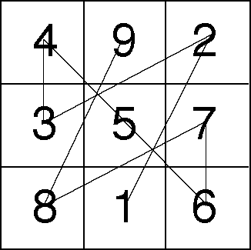
Abstractions
“Make-15” game is an abstraction built upon 9 integers
Tic-Tac-Toe is an abstraction with 3X3 squares and ‘-1’s and ‘1’s
Magic Square is an abstraction with 3X3 squares and 9 integers
-1 | 0 | -1
1 | 0 | 0
0 | 1 | 1
Make-15 game
is equivalent to
Playing Tic-Tac-Toe on a
Magic-Square Board
Tic-Tac-Toe
Magic Square
How to Play Make-15:
- Use Tic-Tac-Toe and Magic Square Abstraction
- Play Tic-Tac-Toe on Magic Square
- How to Win Tic-Tac-Toe

Slide 17
Need an Abstraction Hierarchy
Abstraction Hierarchy
Make-15
Creative Solution/Model?
Find the intermediate abstractions.
So, for creative modeling of problems,
You need
  A good library of intermediate abstractions
  A good knowledge of how to build/find abstraction hierarchies
Tic-Tac-Toe
Magic Square
-1, 0, +1
3X3 Square
1, 2, . . , 9

Slide 18
Computational Thinking is . . .
C.T. is many different things, and
One of them is . . .
C.T. is using abstraction hierarchies and decomposition in tackling a large complex task.

Slide 19
What is an Abstraction?
Concrete elements vs. Abstract idea
  Parts of a car vs. The car
  Parts of a computer vs. The computer
Symbol String: “132” is the value 132
Symbol String: “10000100” is the value 132
Symbol String: 84 is the value 132
Symbol String: 204 is the value 132
Symbol String “One hundred Thirty Two” is the value 132

Slide 20
What is an Abstraction?
Concrete elements vs. Abstract idea
  27 in binary is 11011
  41 in binary is 101001
Add: 27+41 (At abstract level)
Computer performs at concrete level:
  (11011 + 101001)
All images, videos, text files you use on computers are stored as binary data.

Slide 21
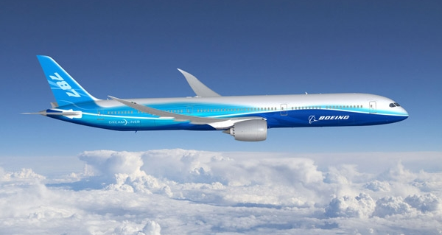
An Engineering Application
Boeing 777 was tested via computer simulation alone,
Not tested in a wind tunnel
How to manage interactions of 1000s of parts?
The plane is abstraction, that is built using a hierarchy of abstractions, at the bottom of which are the bits in the computer.

Slide 22
How to build an abstraction hierarchy for a large and complex system?

Slide 23
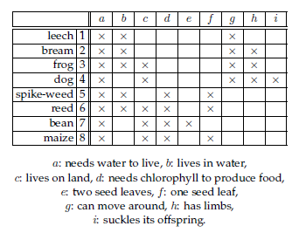
A Large System with Many Components

Slide 24
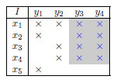
Building a Concept Hierarchy
A concept,
An abstraction.

Slide 25
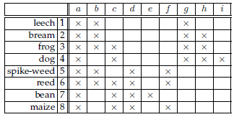
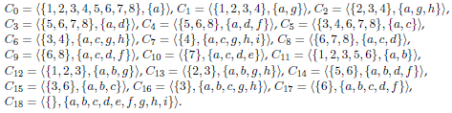
Concepts in the Relationship Table

Slide 26
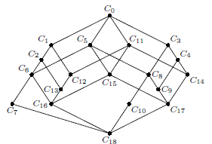
Concept/Abstraction Hierarchy

Slide 27
The First idea of C.T.
Abstractions are our “mental” tools
FCA helps build Abstraction Hierarchy
The abstraction process includes
  Choosing the right abstractions
  Operating simultaneously at multiple layers of abstraction
  Defining the relationships between the layers

Slide 28
Mechanizing Abstractions
The power of our “mental” tools is amplified by our “metal” tools.
Automation is mechanizing our abstractions, abstraction layers, and their relationships
  Mechanization is possible due to precise and exacting notations and models
  There is some “computer” below (human or machine, virtual or physical)

Slide 29
Computational Thinking is Standard Operating Procedure at Google.

Slide 30
The Firing Squad Problem
Five “soldiers” all start in the sleep state. You change the one on the left to the wake state.
All five must get to the fire state at the same time (for the first time).
sleep
wake
fire
sleep
wake
fire
sleep
wake
fire
sleep
wake
fire
sleep
wake
fire
sleep
wake
fire
sleep
wake
fire
sleep
wake
fire
sleep
wake
fire
sleep
wake
fire
Steven Rudich: www.cs.cmu.edu/~rudich rudich0123456789

Slide 31
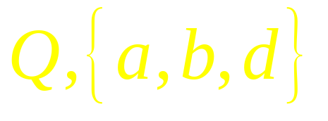
Shorthand
Means use this transition when your left neighbor is in any state at all and your right neighbor is in state a,b, or d.

Slide 32
{sleep,fire,end},Q
sleep
{w},Q
{w3},Q
{w4},Q
{w2},Q
wake
wake2
wake3
wake4
Q,Q
Q,Q
Q,Q
Q,Q
fire!
 | 1 | 2 | 3 | 4 | 5
 | sleep | sleep | sleep | sleep | sleep
 | sleep | sleep | sleep | sleep | sleep
 | sleep | sleep | sleep | sleep | sleep
 | sleep | sleep | sleep | sleep | sleep
 | sleep | sleep | sleep | sleep | sleep

Slide 33
{sleep,fire,end},Q
sleep
{w},Q
{w3},Q
{w4},Q
{w2},Q
wake
wake2
wake3
wake4
Q,Q
Q,Q
Q,Q
Q,Q
fire!
 | 1 | 2 | 3 | 4 | 5
 | wake | sleep | sleep | sleep | sleep

Slide 34
{sleep,fire,end},Q
sleep
{w},Q
{w3},Q
{w4},Q
{w2},Q
wake
wake2
wake3
wake4
Q,Q
Q,Q
Q,Q
Q,Q
fire!
 | 1 | 2 | 3 | 4 | 5
 | wake | sleep | sleep | sleep | sleep
 | wake2 | wake2 | sleep | sleep | sleep

Slide 35
{sleep,fire,end},Q
sleep
{w},Q
{w3},Q
{w4},Q
{w2},Q
wake
wake2
wake3
wake4
Q,Q
Q,Q
Q,Q
Q,Q
fire!
 | 1 | 2 | 3 | 4 | 5
 | wake | sleep | sleep | sleep | sleep
 | wake2 | wake2 | sleep | sleep | sleep
 | wake3 | wake3 | wake3 | sleep | sleep

Slide 36
{sleep,fire,end},Q
sleep
{w},Q
{w3},Q
{w4},Q
{w2},Q
wake
wake2
wake3
wake4
Q,Q
Q,Q
Q,Q
Q,Q
fire!
 | 1 | 2 | 3 | 4 | 5
 | wake | sleep | sleep | sleep | sleep
 | wake2 | wake2 | sleep | sleep | sleep
 | wake3 | wake3 | wake3 | sleep | sleep
 | wake4 | wake4 | wake4 | wake4 | sleep

Slide 37
{sleep,fire,end},Q
sleep
{w},Q
{w3},Q
{w4},Q
{w2},Q
wake
wake2
wake3
wake4
Q,Q
Q,Q
Q,Q
Q,Q
fire!
 | 1 | 2 | 3 | 4 | 5
 | wake | sleep | sleep | sleep | sleep
 | wake2 | wake2 | sleep | sleep | sleep
 | wake3 | wake3 | wake3 | sleep | sleep
 | wake4 | wake4 | wake4 | wake4 | sleep
 | fire | fire | fire | fire | fire

Slide 38
Intermediate Abstractions
Abstraction Hierarchy
Abstraction Hierarchy
Make-15
5 Soldiers
Tic-Tac-Toe
Magic Square
DFA
W1, W2, . W5
-1, 0, +1
3X3 Square
1, 2, . . , 9
Left, Right
Transitions
Sl, Wk, Fr
Example-1
Example-2

Slide 39
Question
Can you build the soldier’s finite automaton brain before you know how many soldiers will be in the line?
No. Finite automata can’t count!
Steven Rudich: www.cs.cmu.edu/~rudich rudich0123456789

Slide 40
Don’t jump to conclusions! It is possible to design a single cellular automaton that works for any number of soldiers!
Steven Rudich: www.cs.cmu.edu/~rudich rudich0123456789

Slide 41
Four Cornerstones of Computational Thinking
Problem Decomposition
  Breaking down a complex problem into smaller, manageable parts
Pattern Recognition
  Looking for Similarities among and within problems
Abstractions
  Focusing on the important aspects and ignoring the irrelevant details
Algorithms
  Developing a step-by-step solution to the problem, or the rules to follow to solve the problem

Slide 42
What is Computational Thinking?
It is NOT programming
It is NOT even thinking like a computer
It is your thinking about what to tell the computer to do
When you drive: Finalizing the route is comp thinking; following the directions for this route is programming
It is the ability to turn a complex problem into simpler ones that you know how to solve.

Slide 43
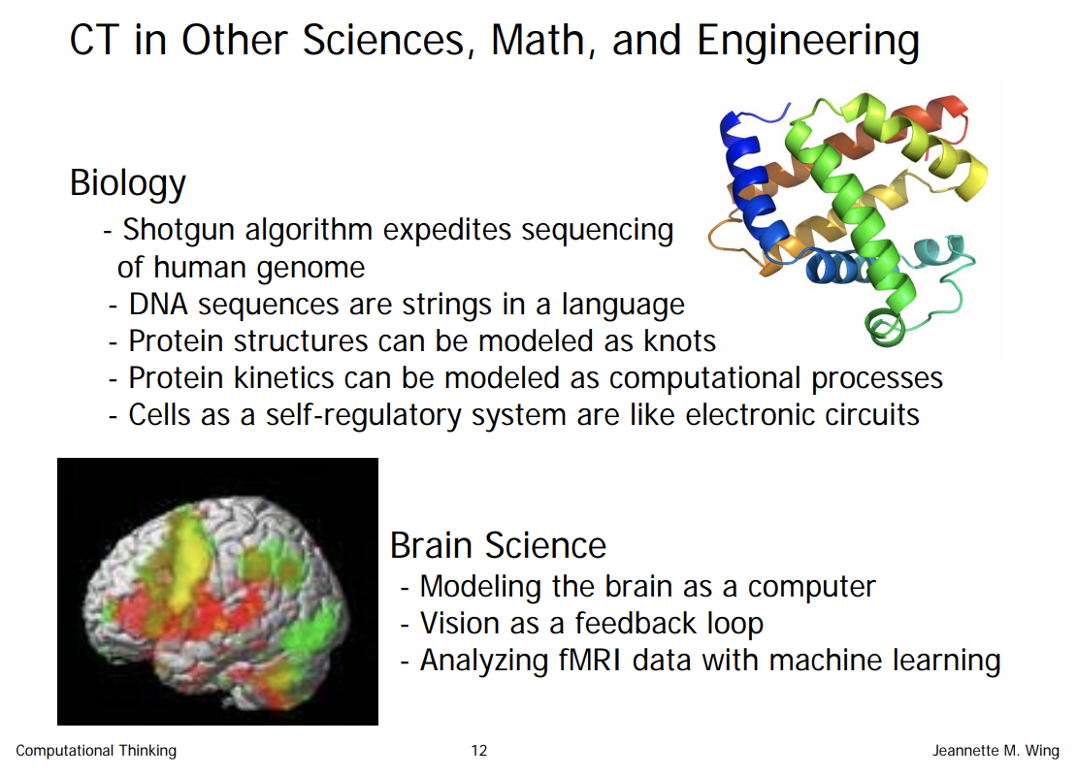

Slide 44
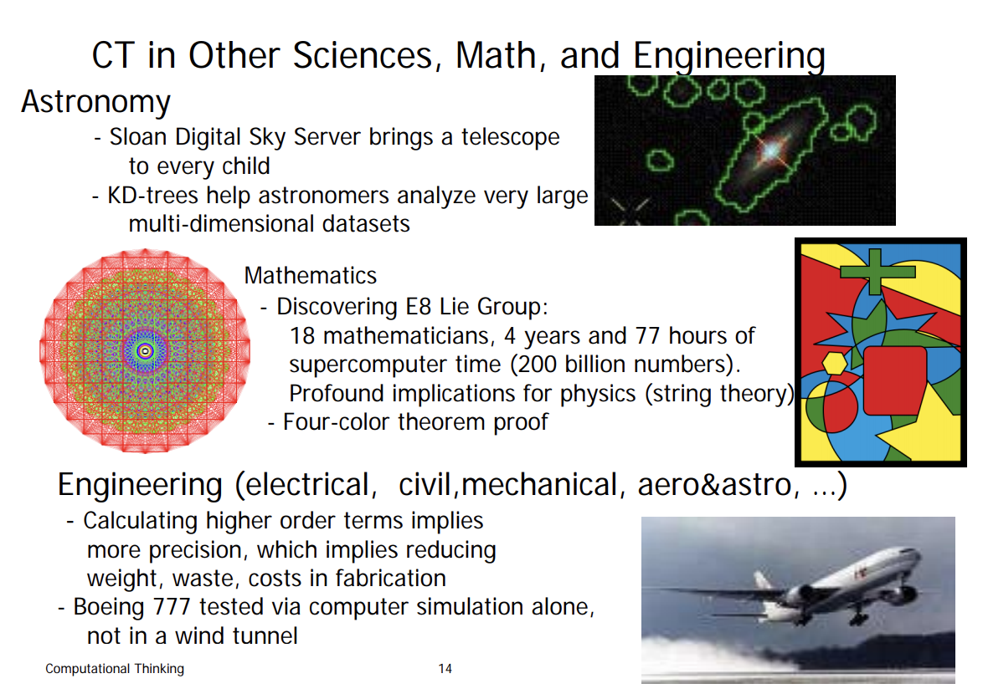

Slide 45
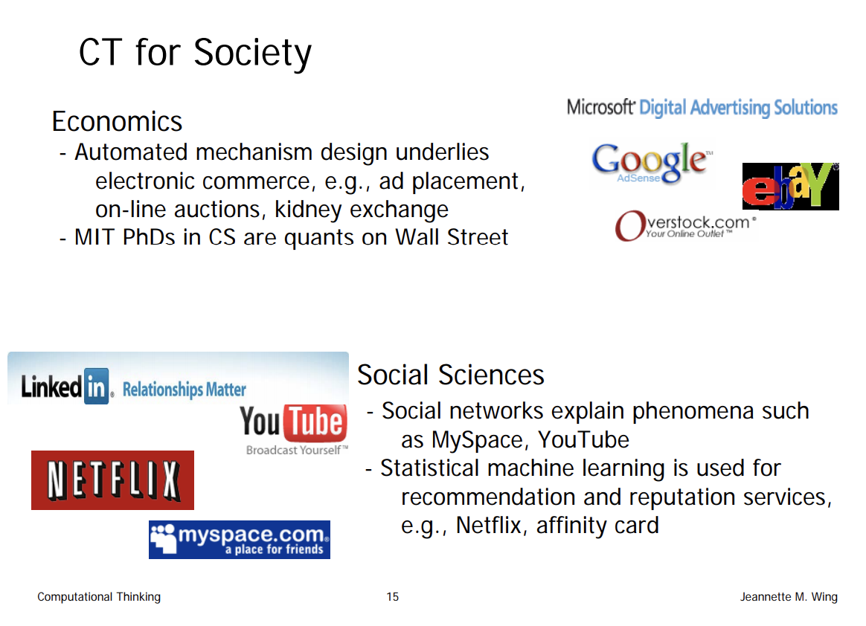

Slide 46
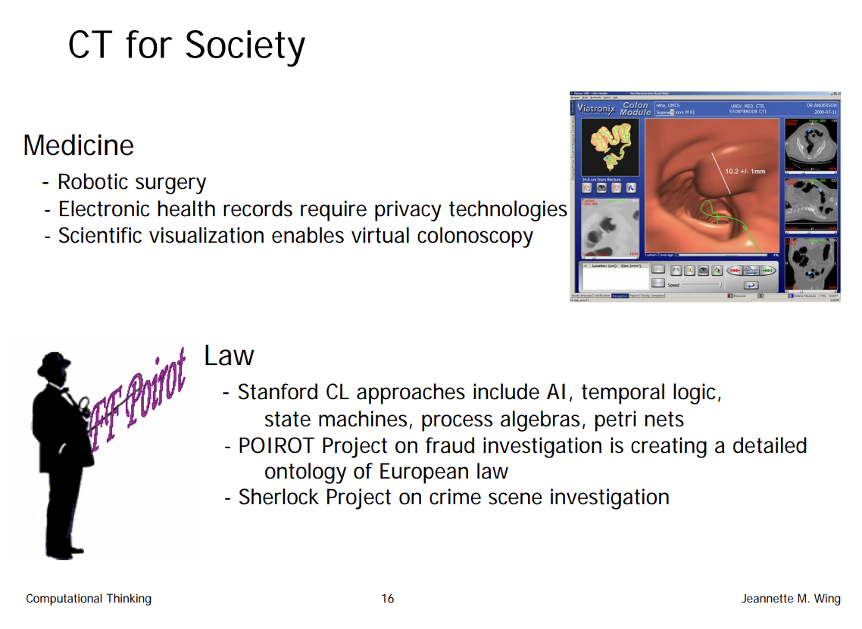

Slide 47
Isn’t Mathematics Enough for Abstractions?
“Applied Computer Science is now playing the role that mathematics did from the 17th through the 20th centuries: providing an orderly, formal framework and explanatory apparatus for other sciences” - G. Djorgovski
Ideas from Maths were the intermediate abstractions for modeling problems
Now the problems have become much more complex, much larger, and very different in nature
Need a different library of intermediate abstractions

Slide 48
An Equation Model vs. a Process Model
Memory/Data
Equation Model (Math Function)
z = f(w,x,y)
Process Model(Computer Program Function)
has local memory
can access global memory
sophisticated control of the steps depending on the data and memory
Differences: A process
Builds, sustains, updates, and retrieves
local memory/data
Control depends on local memory and data
Steps can build very sophisticated intermediate abstractions, and their hierarchies
Inputs: (w, x, y)
Memory/Data
Process
  Step-1: If. . .
  Step-2:
  While..do
  . . .
  Step-n
f
Outputs: (z)
- Protein kinetics can be modeled as computational processes

Slide 49
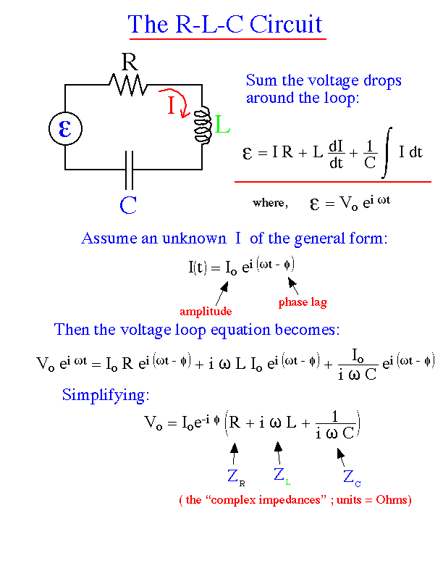
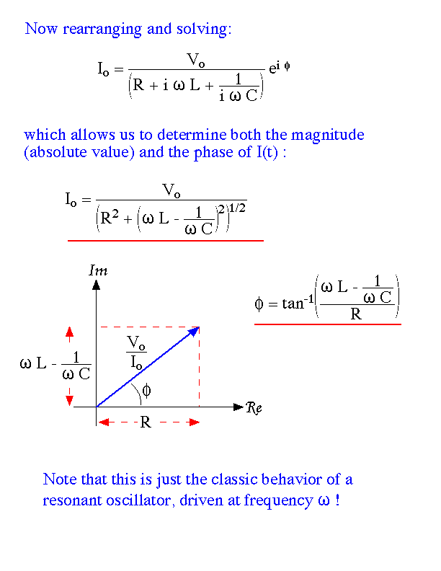
RLC Circuit Analysis: Equation Model
The RLC Circuit Analysis
Circuit Simulator

Slide 50
Computational Thinking is . .Many More Things
C.T. is many different things, and
C.T. is type checking, as a generalization of dimensional analysis.
C.T. is calling gridlock deadlock and avoiding race conditions when synchronizing meetings.
C.T. is thinking recursively.
C.T. is reformulating a seemingly difficult problem into one which we know how to solve.
  Reduction, embedding, transformation, simulation
C.T. is interpreting code as data and data as code.

Slide 51
New Kinds of Questions
New Kinds of Answers
Too much Data
  Genomic signatures
  Social Networks
  Satellite imagery
  Search Engine Data

Slide 52
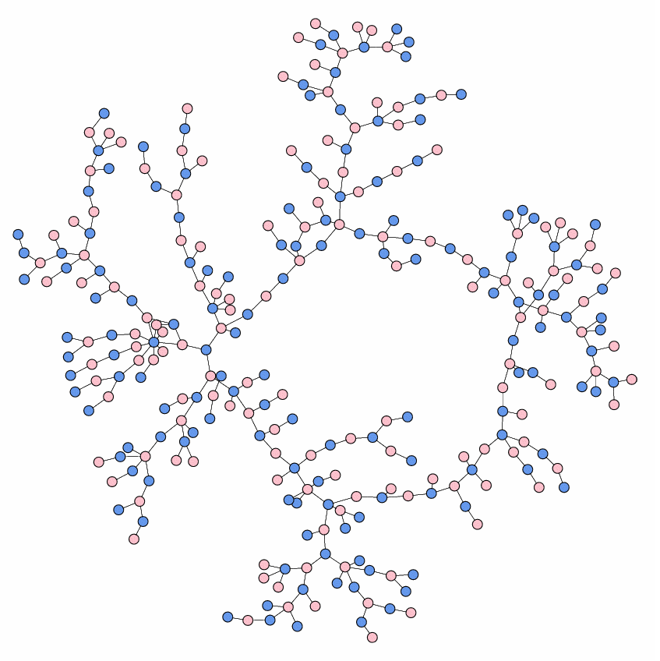

Slide 53
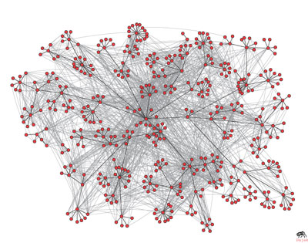

Slide 54
